Slide 1
BRSR Carbon Calculator
One-Click Carbon Reporting for Indian Companies
Automating SEBI BRSR Compliance

Slide 2
The Problem
The SEBI Mandate
Top 1000 listed companies must disclose carbon footprint via BRSR. Plus MSMEs supplying to large firms (Tata, Reliance, etc.) and MSMEs exporting internationally must also report.
Current Issues
⏱️ Time: Weeks of manual work
🎯 Accuracy: High risk of manual errors
💰 Cost: ₹50K - ₹5L in consulting fees
📋 Compliance: Audit failures costly
50M+ Companies Face This Challenge

Slide 3

Our Solution
Transform complex GHG calculations into simple, one-click, audit-ready outputs
✓ Automated
✓ Fast
✓ Affordable
All 3 scopes calculated instantly with verified emission factors
20 minutes instead of weeks. 90% time savings
90% cost reduction vs hiring consultants
✓ Compliant
✓ Audit-Ready
✓ Scalable
100% SEBI BRSR compliant reports
Verified calculations, complete audit trail
Works for MSMEs to large corporations

Slide 4



How It Works: 3 Simple Steps
1
2
3
Input Data
Calculate
Get Report
Enter fuel, electricity, and travel data from your bills
System uses verified emission factors to calculate total CO₂e
Download SEBI BRSR-compliant PDF and Excel reports
Diesel/Petrol (liters)
Electricity (kWh)
Travel (km)
Audit-ready
Submit to SEBI
Activity × Factor = CO₂e

Slide 5

Market Opportunity
₹500+ Crore Market
Consulting fees we're replacing with software
1,000 Listed Companies
MSMEs: Suppliers
MSMEs: Exporters
SEBI mandatory reporting requirement
Companies supplying to Tata, Reliance, large corporations
Companies exporting to international markets
100% Compliance Required
Supply Chain Pressure
Global Compliance
50M+
Growing
Urgent
Total MSMEs in India
ESG mandate expanding
Immediate compliance need

Slide 6

Why We Win
✓ Technical Feasibility
✓ Economic Efficiency
Robust, cloud-native architecture. Verified, rule-based logic guarantees audit-grade accuracy
90% cost reduction. Low-cost model viable for MSMEs, effective for large corporations
✓ Mandatory Market
✓ First-Mover
Legally required BRSR reporting. Ensures rapid adoption across entire spectrum
First automated solution in India. Building brand recognition early
Competitive Advantages
20 min
90%
100%
0%
vs weeks (consultants)
Cost savings
SEBI compliant
Manual errors

Slide 7

Business Model
SaaS Subscription Model
Replacing consulting services with affordable software
MSMEs Tier
Enterprise Tier
Premium Add-ons
₹X,XXX/year
₹XX,XXX/year
Custom
Basic features, annual reports
Advanced features, multi-location
Carbon reduction insights, API access
All 3 scopes
PDF/Excel reports
Email support
All MSME features
Multi-year tracking
Priority support
AI recommendations
ERP integration
White-label
Revenue Streams
Acquisition Strategy
Subscriptions + Premium Features + Integrations
Direct outreach + Partnerships + Industry associations

Slide 8
Product Roadmap
DONE ✓
Phase 1: Core Platform
Scope 1, 2, 3 calculations • SEBI BRSR-compliant reports • PDF/Excel export
IN PROGRESS
Phase 2: Enhanced Features
Multi-year tracking • Carbon reduction recommendations • Mobile app
PLANNED Q2
Phase 3: Integrations
API for third-party platforms • ERP integration (Tally, SAP) • Real-time data sync
FUTURE
Phase 4: AI & Automation
AI-powered insights • Automated offsetting • Sustainability score • Benchmarking

Slide 9
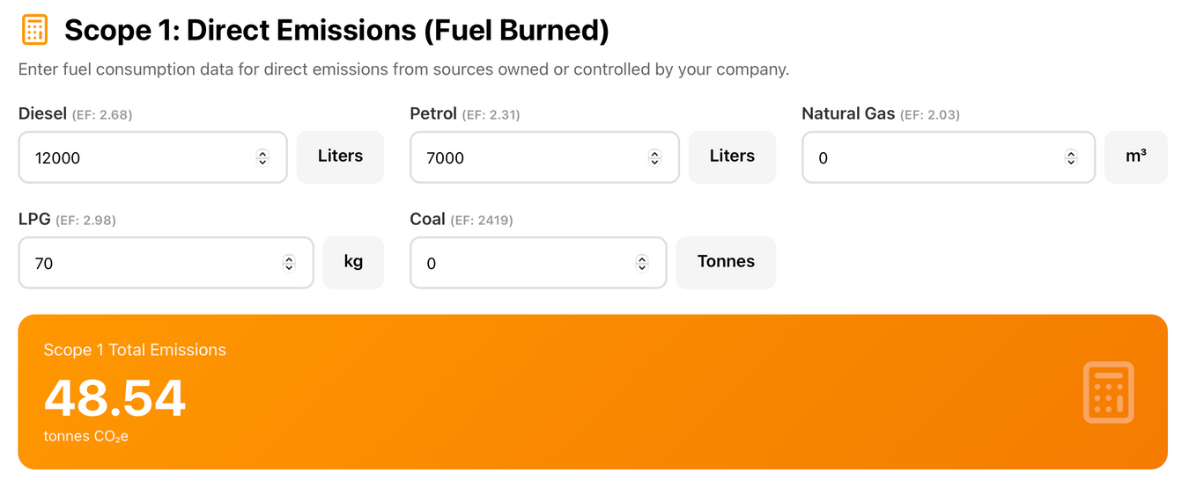
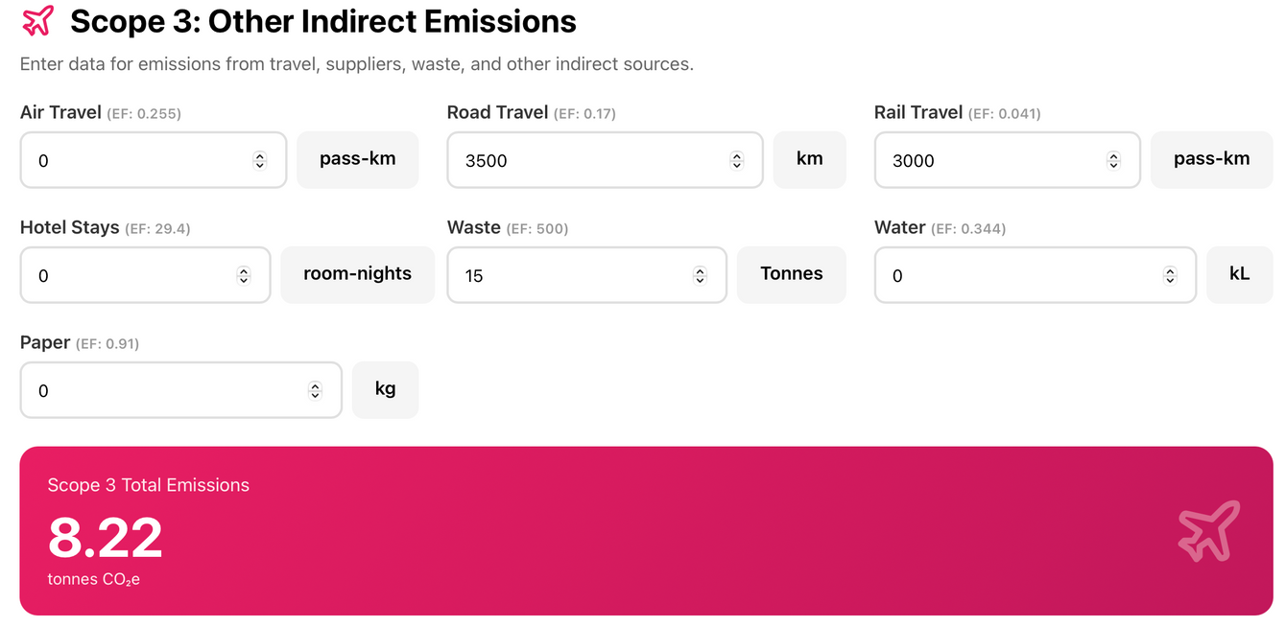
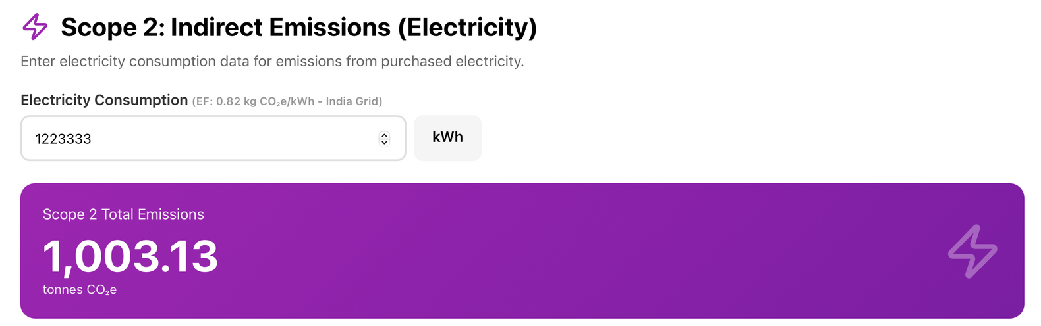

Slide 10
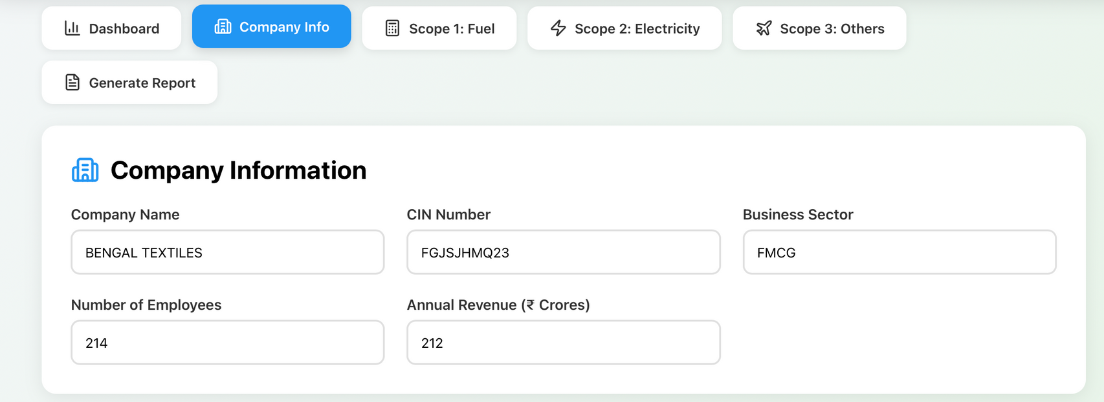
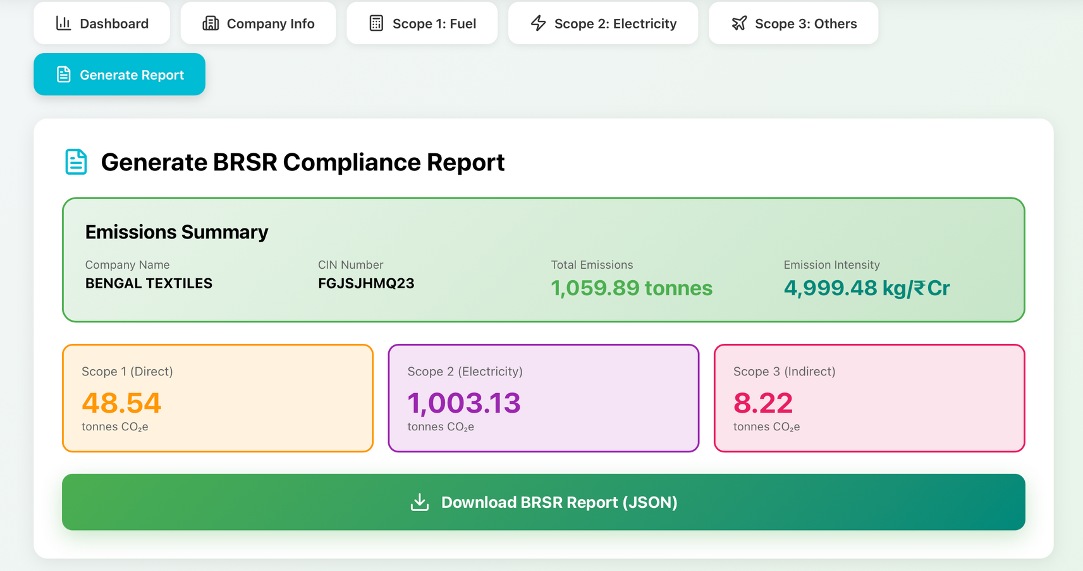
OUTPUT

